Slide 1
How-To-Use: Spec Analysis Tool
MATLAB scripts needed:
spec_analysis_calc.m, get_cti_files.m, spec_analysis_xls.m, add_specs_to_template.m, add_calculations_to_spec_analysis_workbook.m, make_CDF_spec_plots.m, amp_spec_analysis.m, gain_spec_analysis.m, gd_spec_analysis.m, MaxAmpVar1.m, MaxGDVar1.m, Readcti.m, Readcti1.m, smooth.m, smooth1.m, Var.m, vswr_spec_analysis.m
Also needed:
Spec_Analysis_template.xlt, RFE_specs.xls

Slide 2
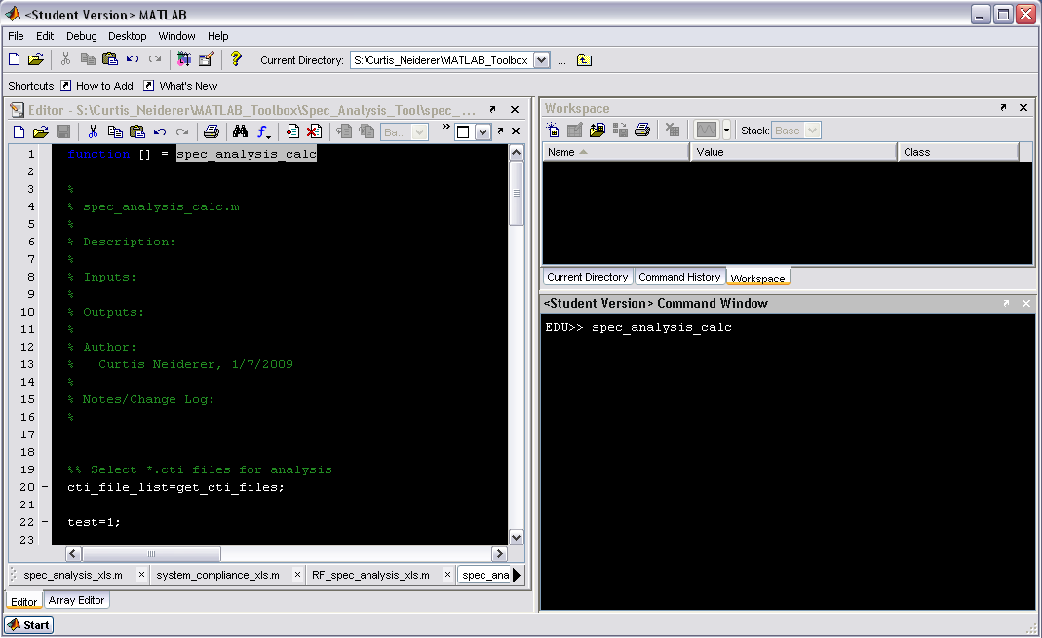
Type spec_analysis_calc at the command line

Slide 3
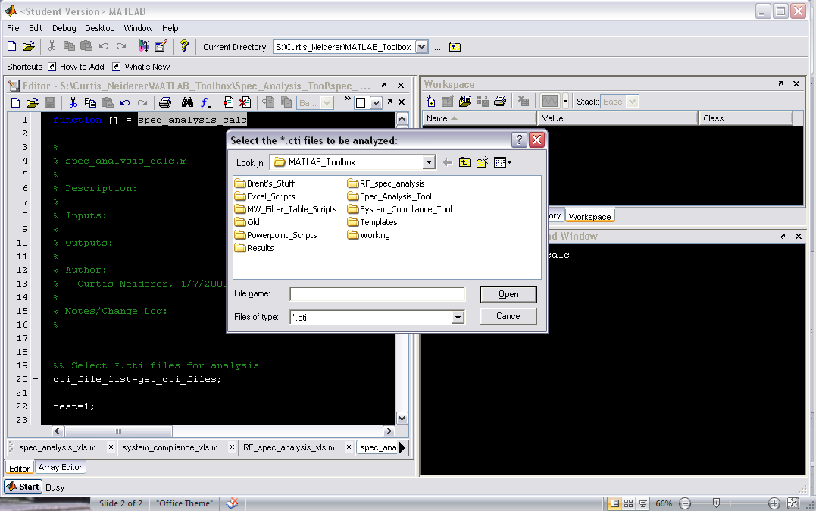
Browse to the *.cti files to be analyzed

Slide 4
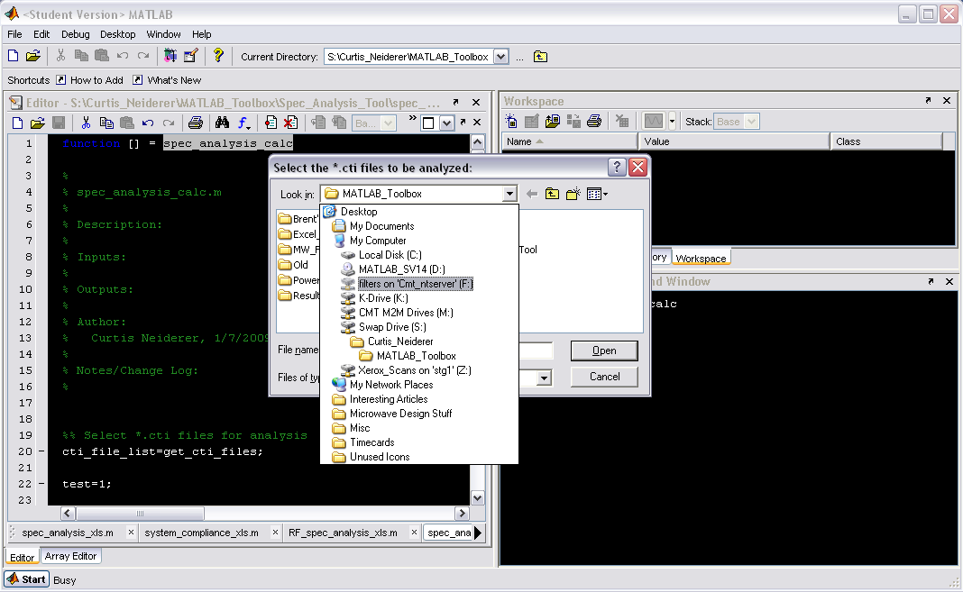

Slide 5
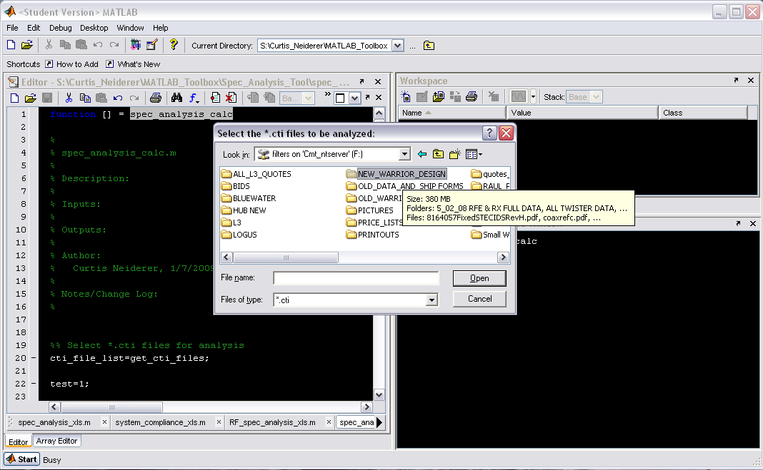

Slide 6
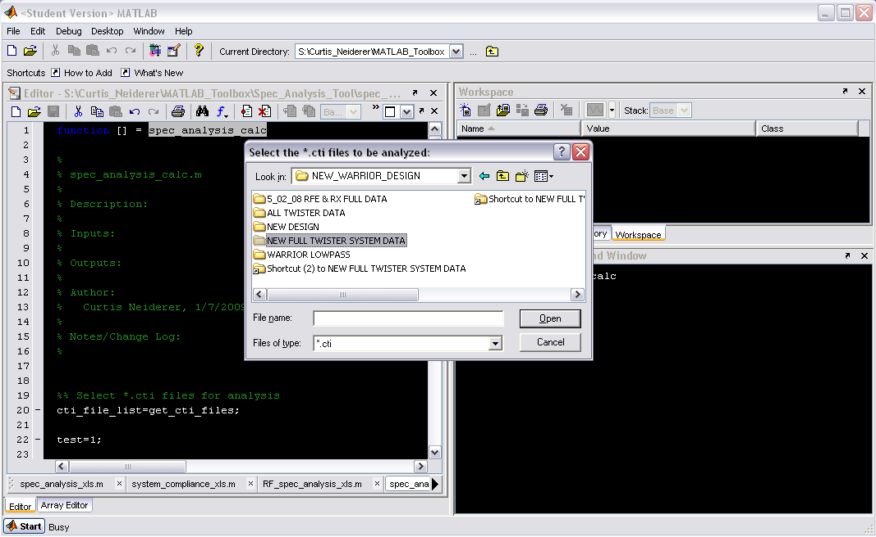

Slide 7
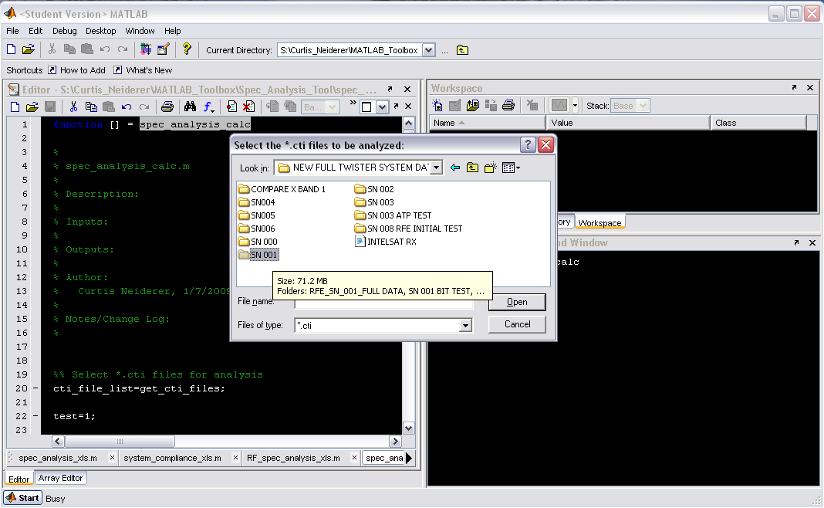

Slide 8
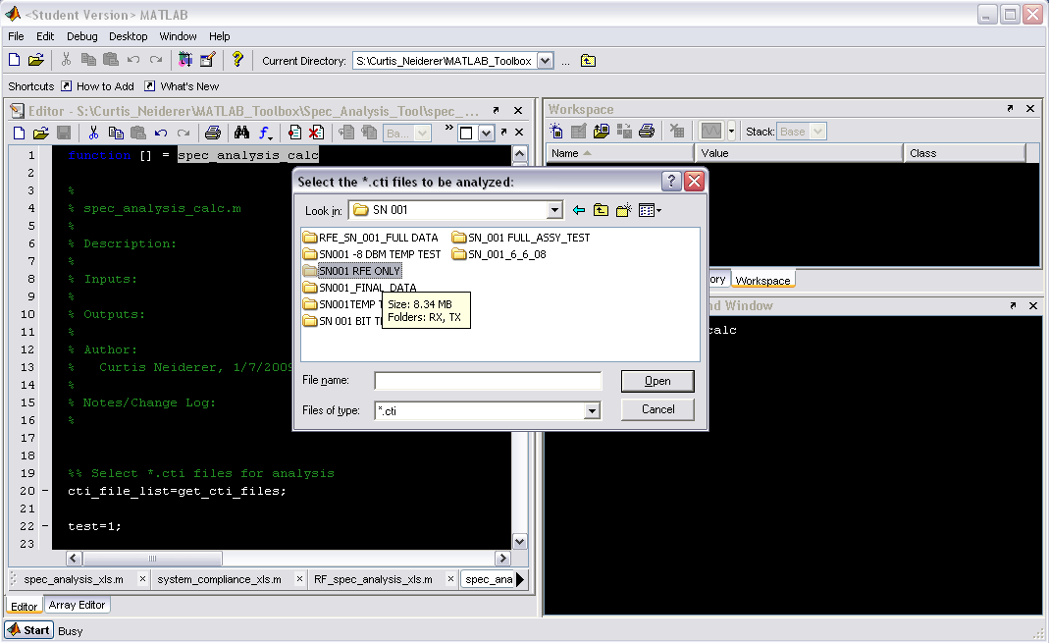

Slide 9
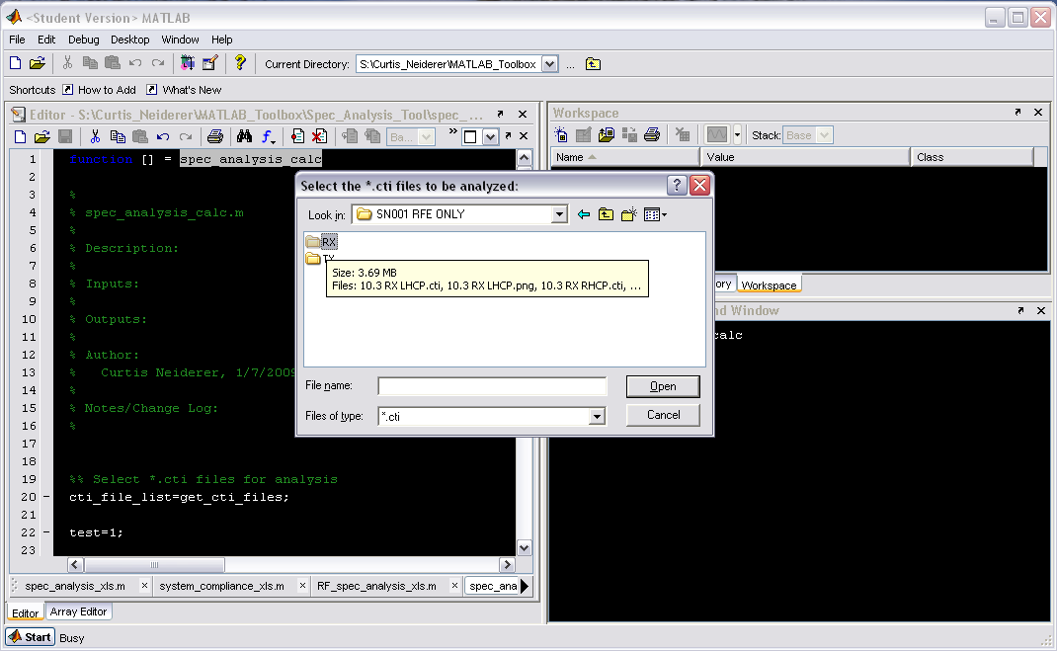

Slide 10
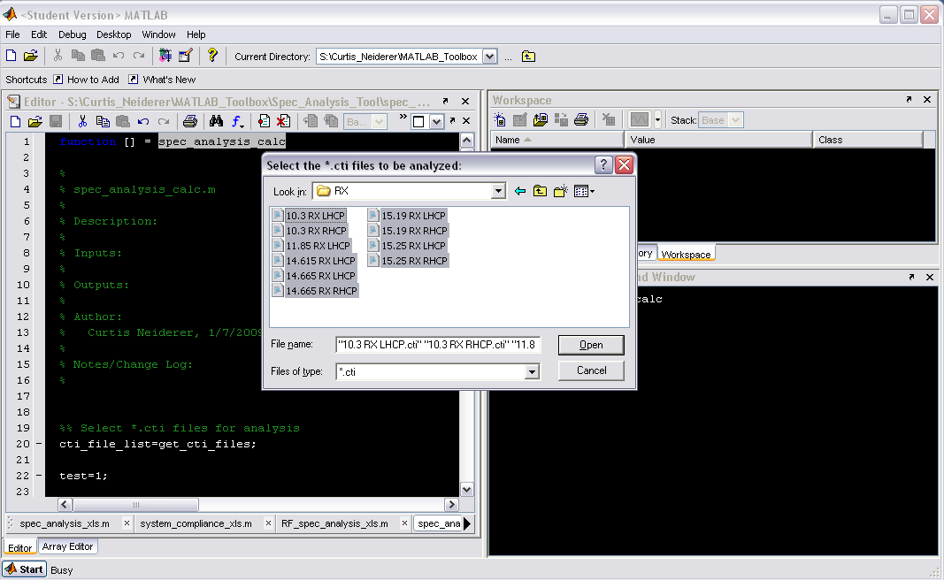
Select the set of *.cti files to be analyzed

Slide 11
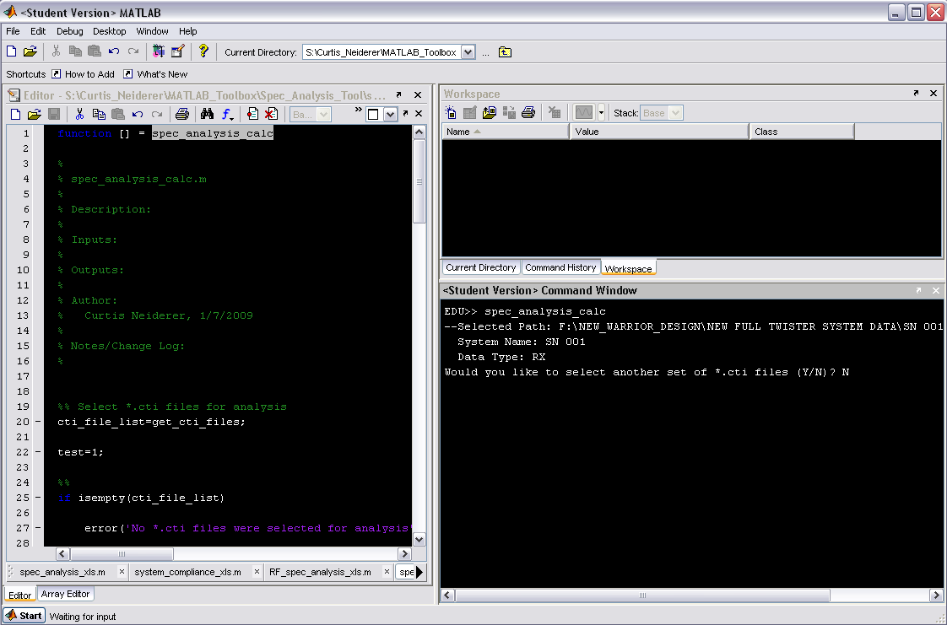
You will be prompted to either select another set or not. If you choose to, repeat above steps as necessary.

Slide 12
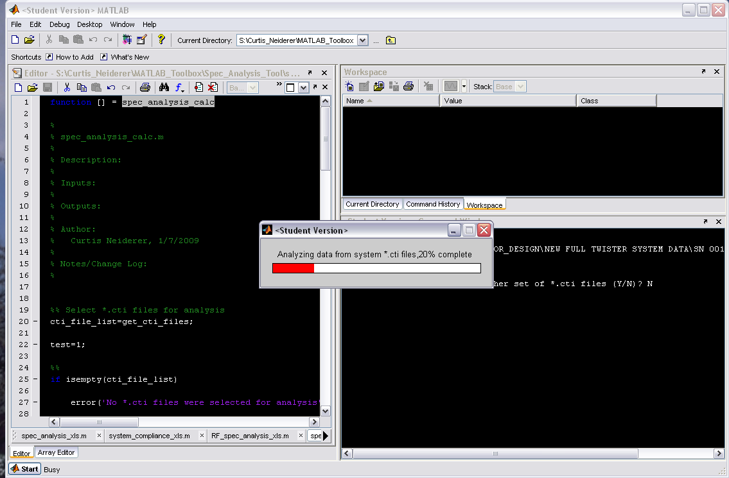
Following selection of files, a waitbar will pop-up to show analysis progress.

Slide 13
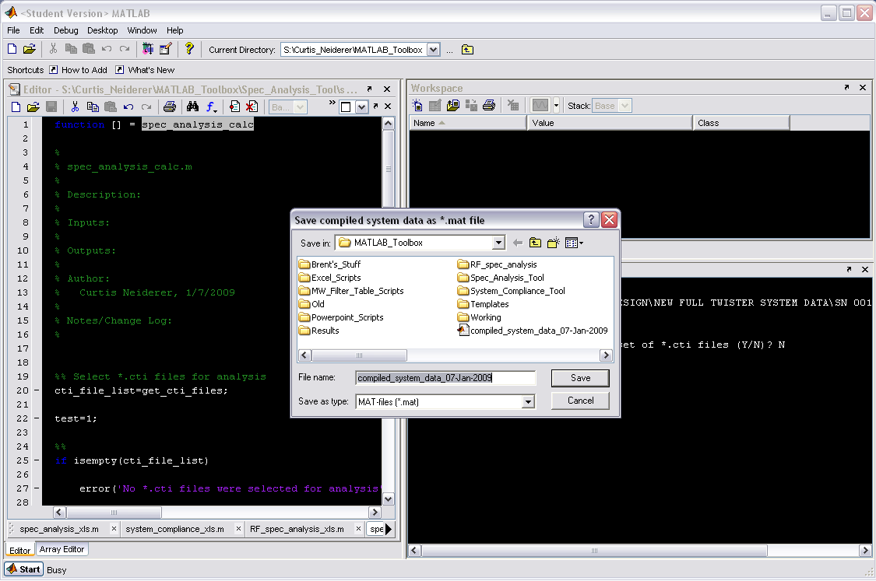
After analysis is complete, you will be prompted to select a name and location to save the compiled data.

Slide 14
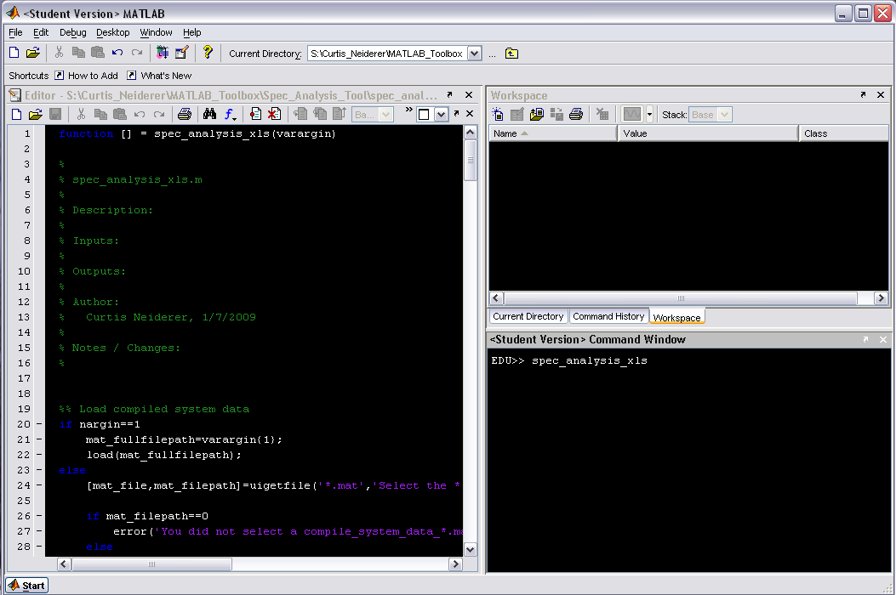
Type spec_analysis_xls at the command line

Slide 15
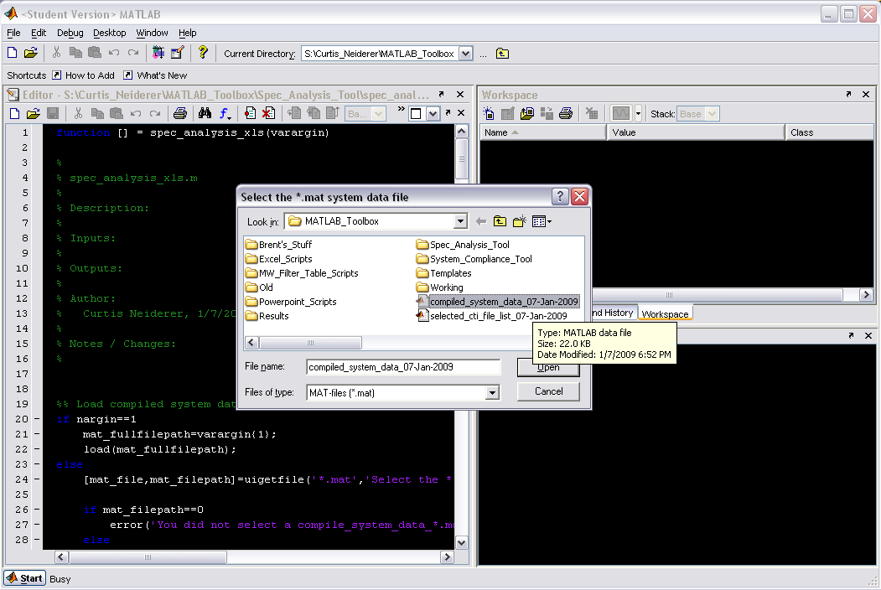
Select the *.mat system data file you created with spec_analysis_calc

Slide 16
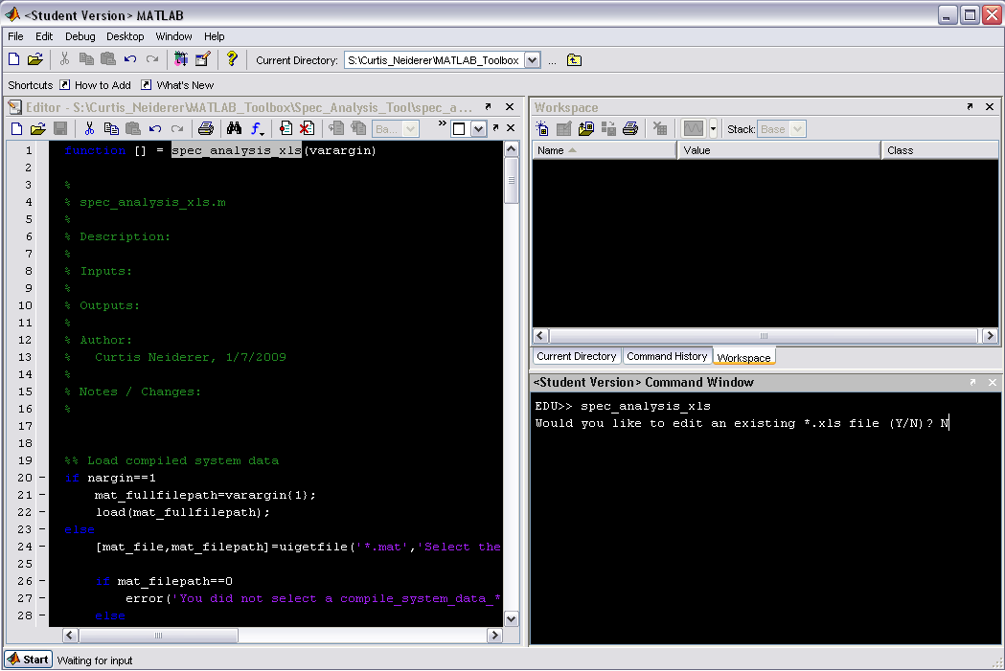
You will then be asked if you would like to edit an existing excel workbook.

Slide 17
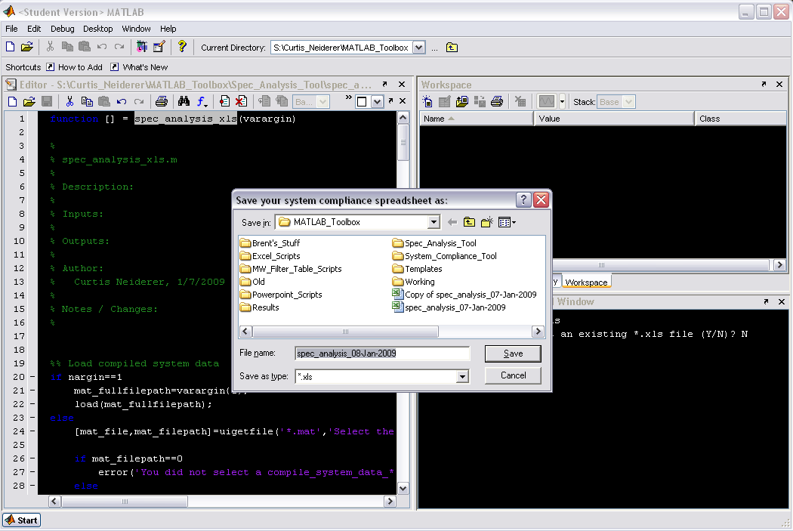
If you enter “Y”, browse to and pick the existing workbook; if you pick “N”, choose a name and location to save the new workbook.

Slide 18
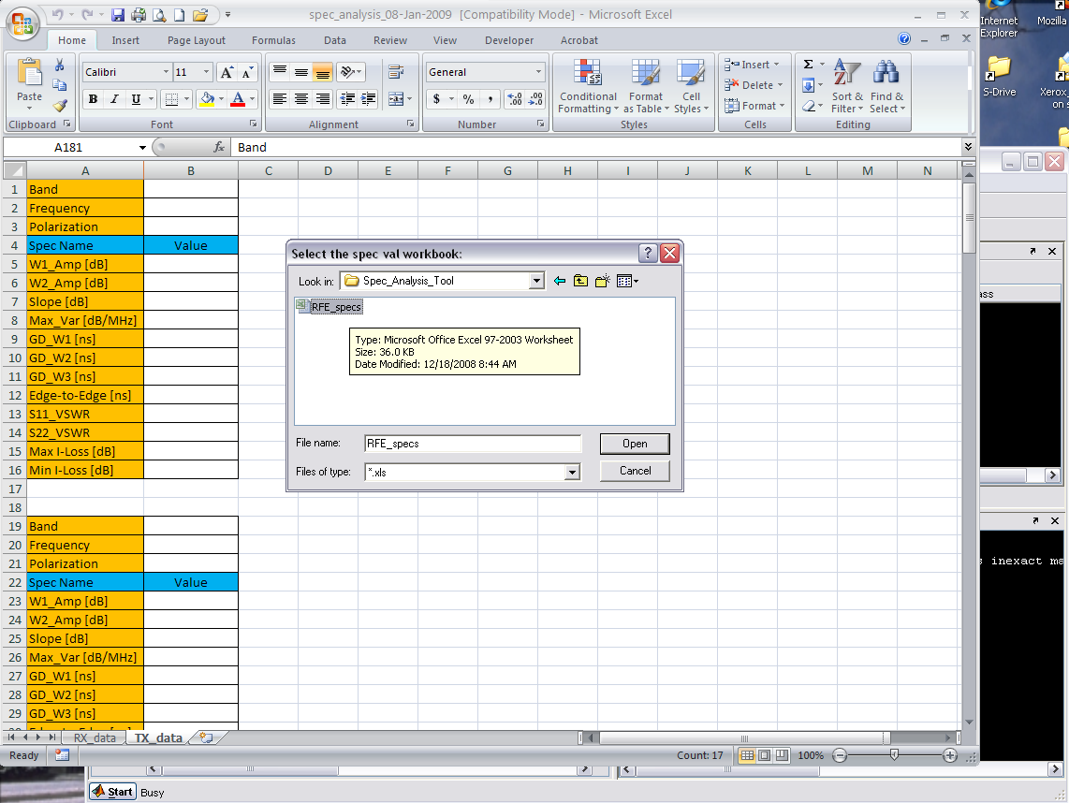
You will then be prompted to pick the spec values workbook to get your RFE spec values.

Slide 19
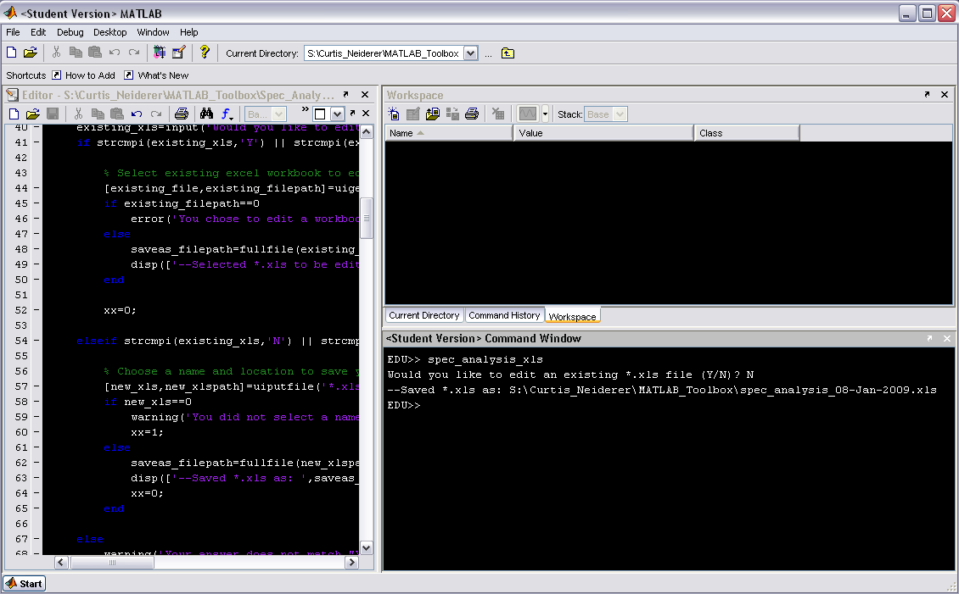
The location of the workbook you saved will be output to the command line.

Slide 20
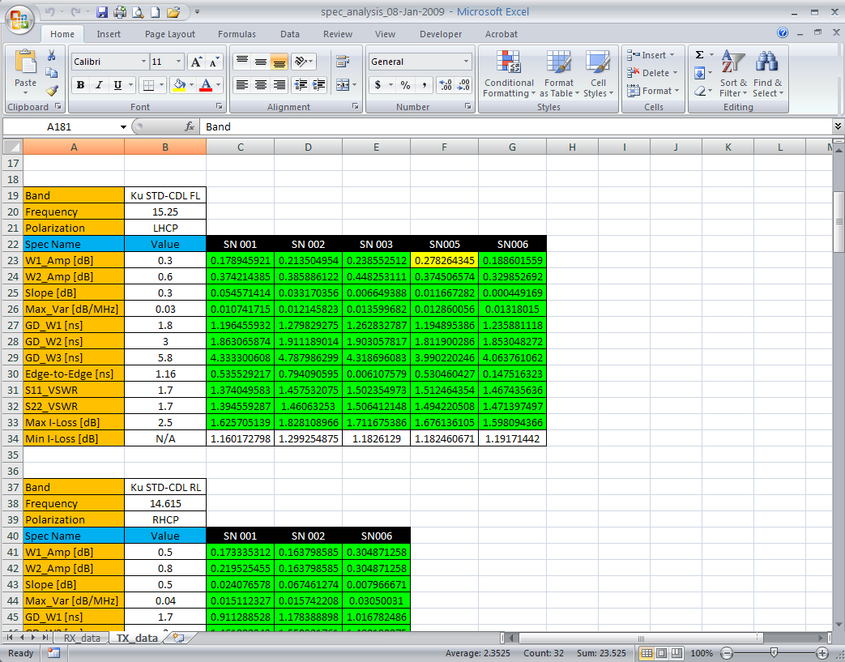
Here’s a quick snapshot of what the workbook will look like afterwards.

Slide 21
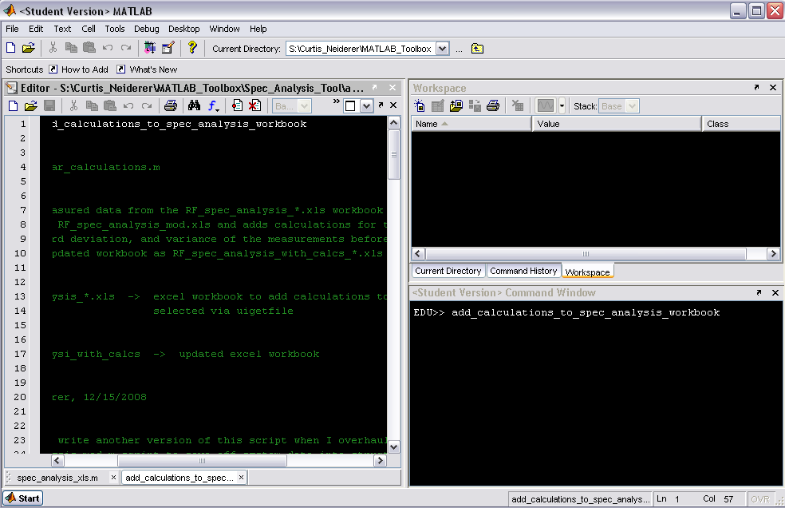
Type add_calculations_to_spec_analysis_workbook at the command line

Slide 22
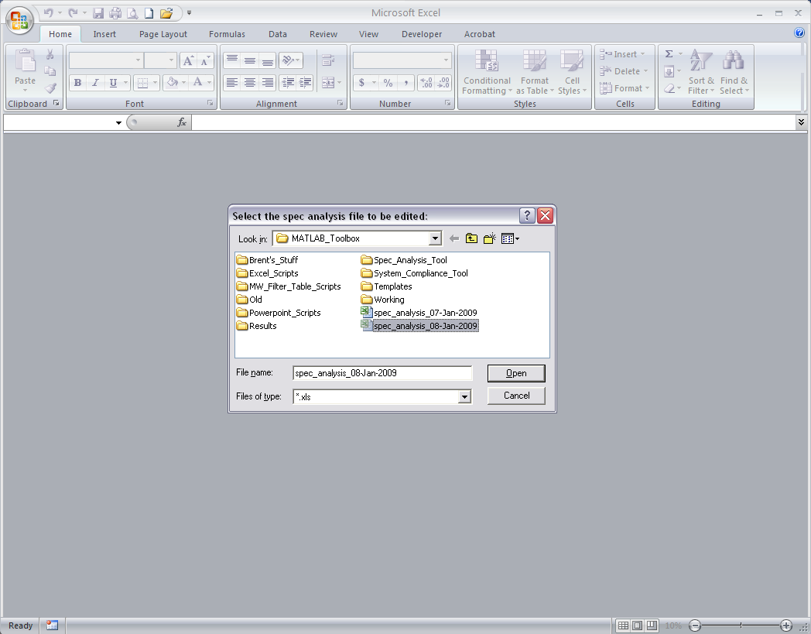
Choose the workbook that you would like to add your mean, std, and variance calculations to.

Slide 23
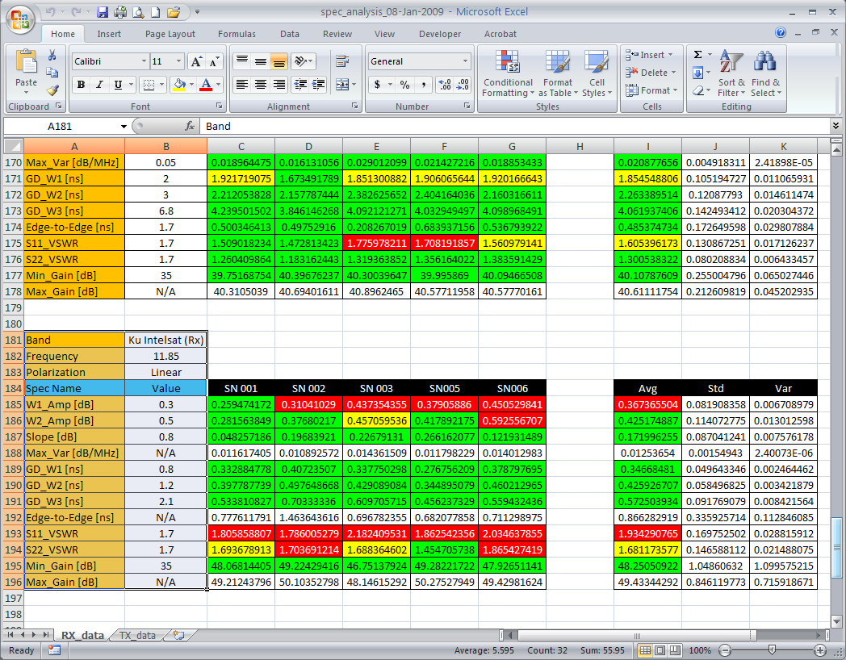
Here’s a brief snapshot of what the workbook will look like afterwards.

Slide 24
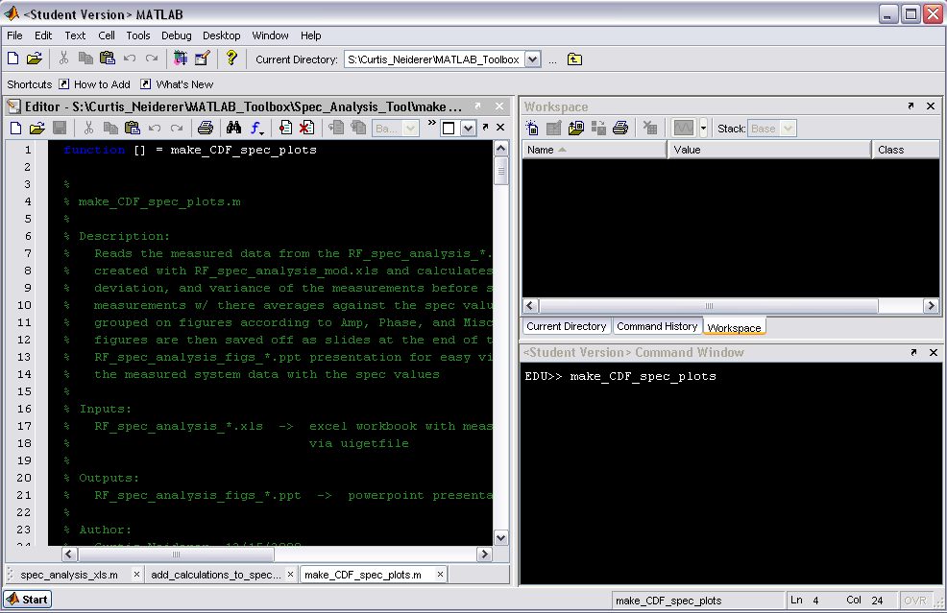
Type make_CDF_spec_plots at the command line to create CDF_spec_plot powerpoint

Slide 25
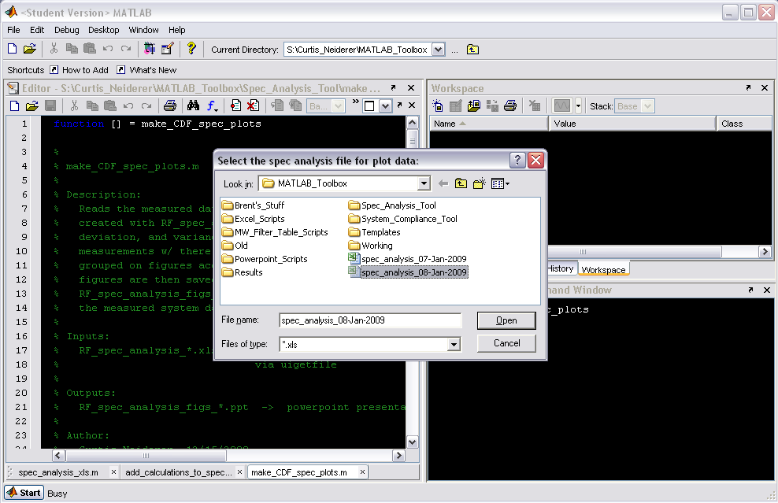
Pick the workbook you will be pulling the plot data from (i.e., the mean, std, and variance calculations)

Slide 26
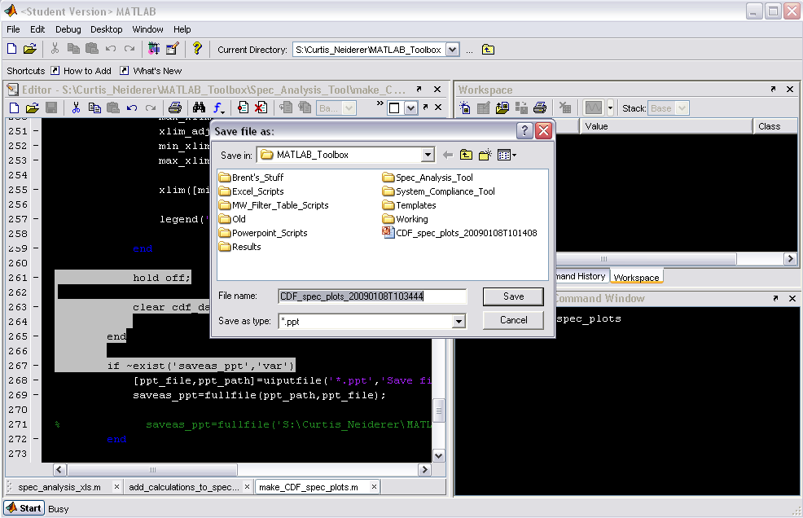
Select the name and location to save the powerpoint presenation to.

Slide 27
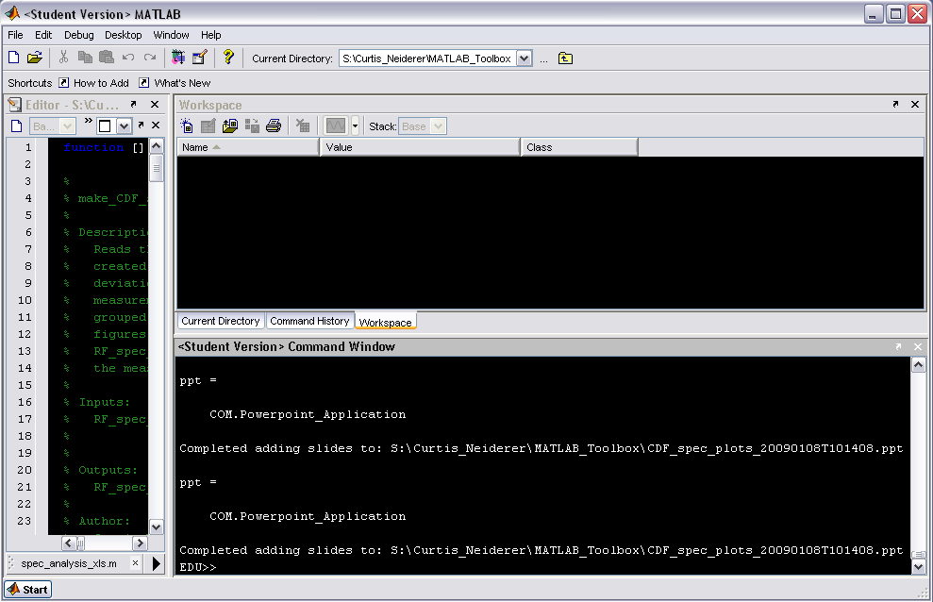
MATLAB will then begin creating and copying figures to powerpoint

Slide 28
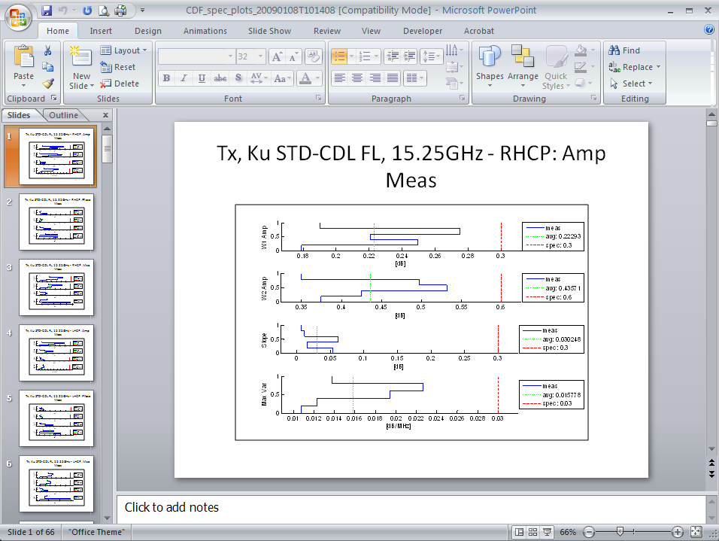
Snapshot of what the powerpoint presentation will look like.

Slide 29
Congratulations, you’re done!!!

